Slide 1
Fitting Lasso Regression Models on Perspective Text Data
Tutorial on lasso regression in R: https://afit-r.github.io/regularized_regression#lasso

Slide 2
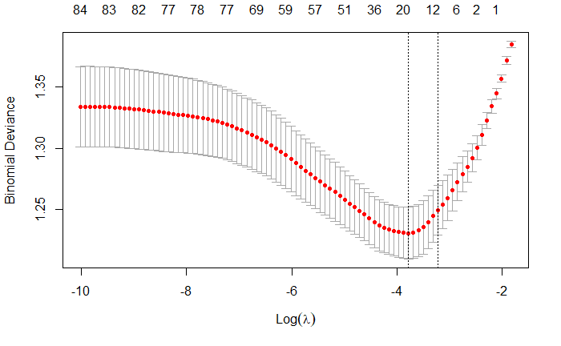
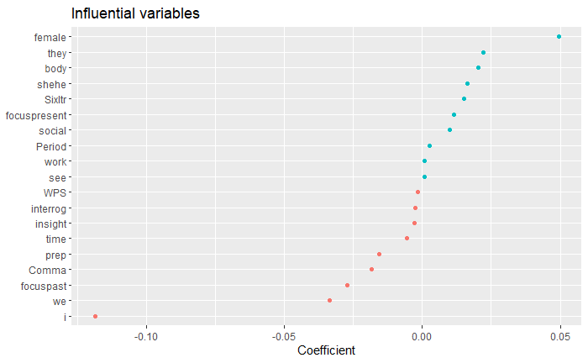
Train machine learning on LIWC features
Model predicting perspective (-1 = 1p, 1p=3p); Accuracy = 68.59%

Slide 3
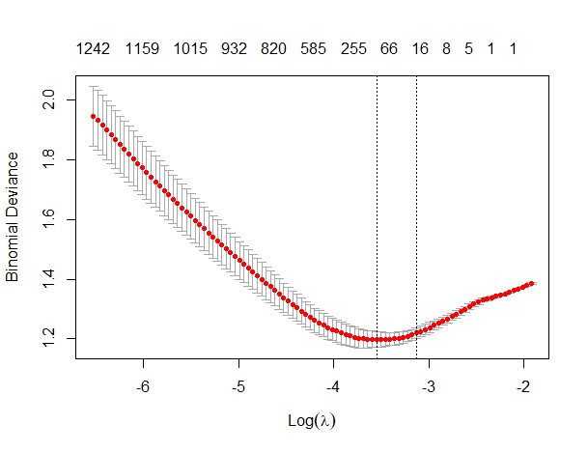
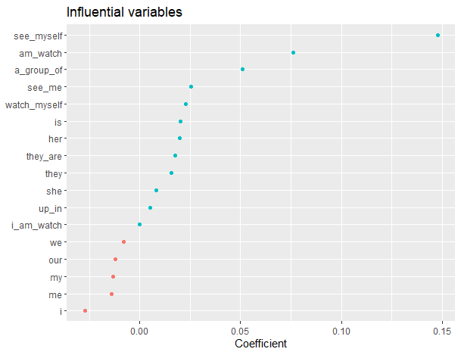
Train machine learning on n-grams (all words)
Model predicting perspective (-1 = 1p, 1p=3p); Accuracy = 69.51% - 72.29%
*lambda 1se

Slide 4
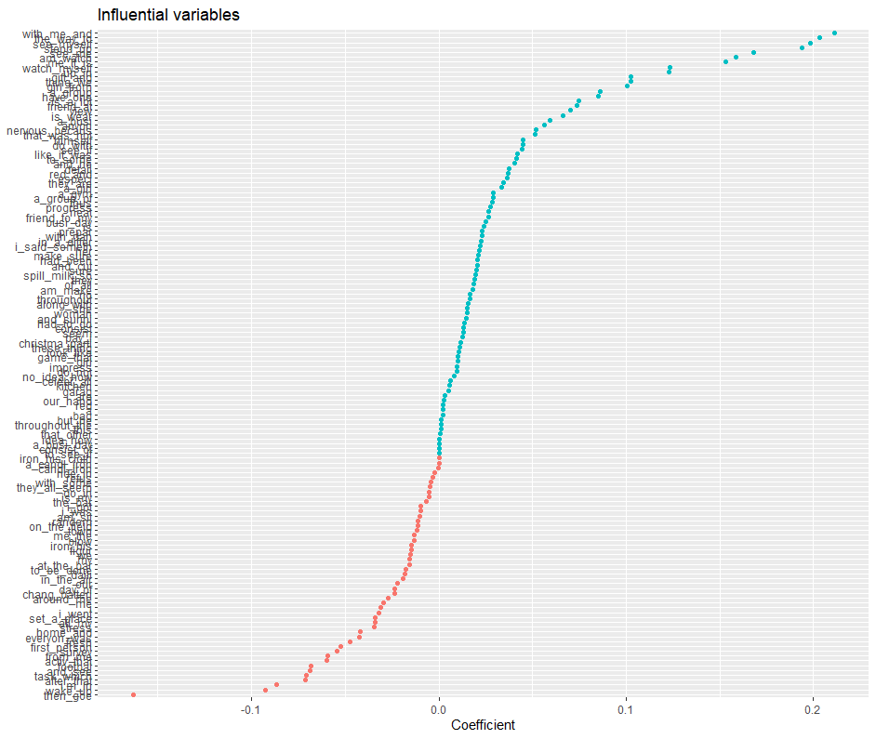

Slide 5
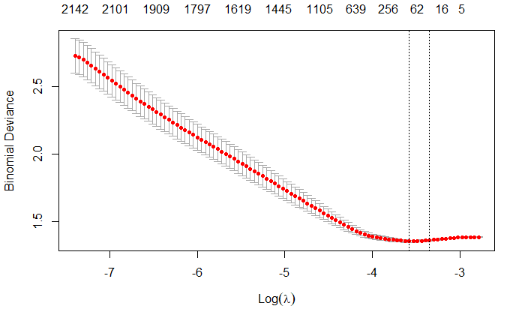
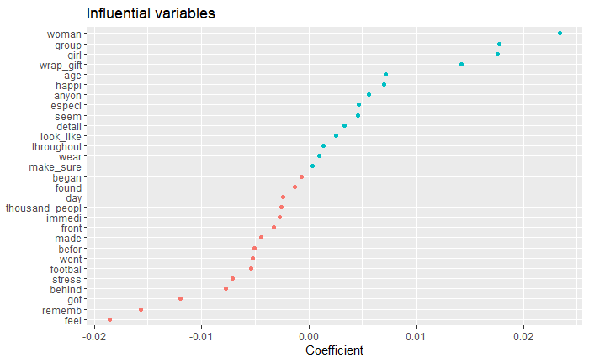
Train machine learning on n-grams (without function words)
Model predicting perspective (-1 = 1p, 1p=3p); Accuracy = 57.27%

Slide 6
